Slide 1




WEBSITE EVALUATION USING OPINION MINING
HELLO
WE ARE
:
Aishwarya Ramesh
Gayathri Ganesan
Harihara Palaninathan
Aarthan Arumugam
Adeniyi Abiodun

Slide 2


Content
Introduction
Basic Features
Advanced Features
User Interface

Slide 3

INTRODUCTION
The Website Evaluator is an AI-based Model, that analyses the comments and uses opinion mining for evaluating a website. The model includes data aggregation, preprocessing, and sentiment analysis algorithms.
We’re also incorporating comment aggregation, aspect-based sentiment analysis for a dynamic rating system.
We have created an interactive dashboard using Streamlit that integrates all of the necessary features under one umbrella.

Slide 4


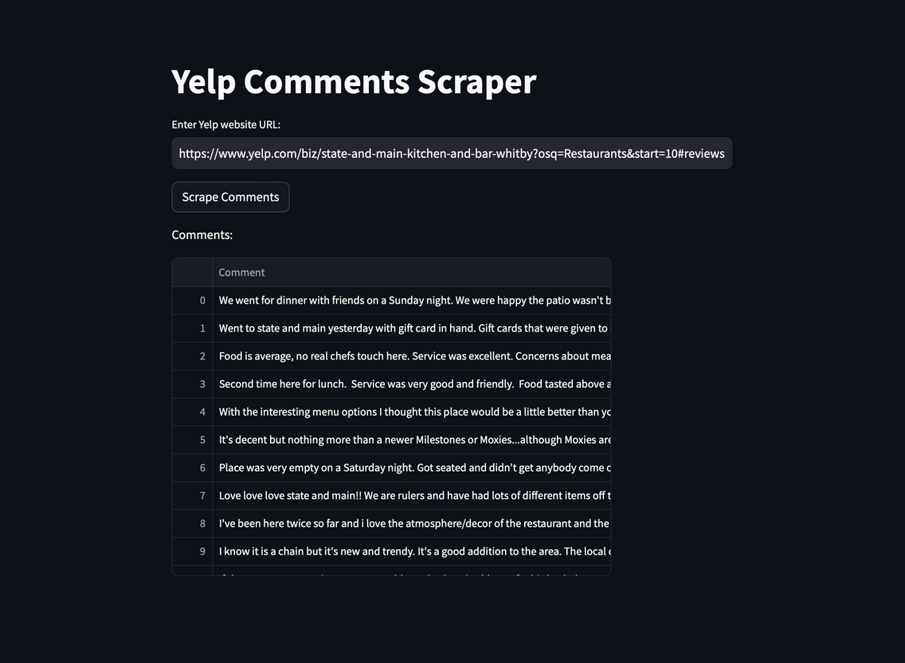

Basic Features
1.Comment Aggregation:
Extracting all the comments/reviews from a website in order to understand the rating and sentiment of the website.

Slide 5


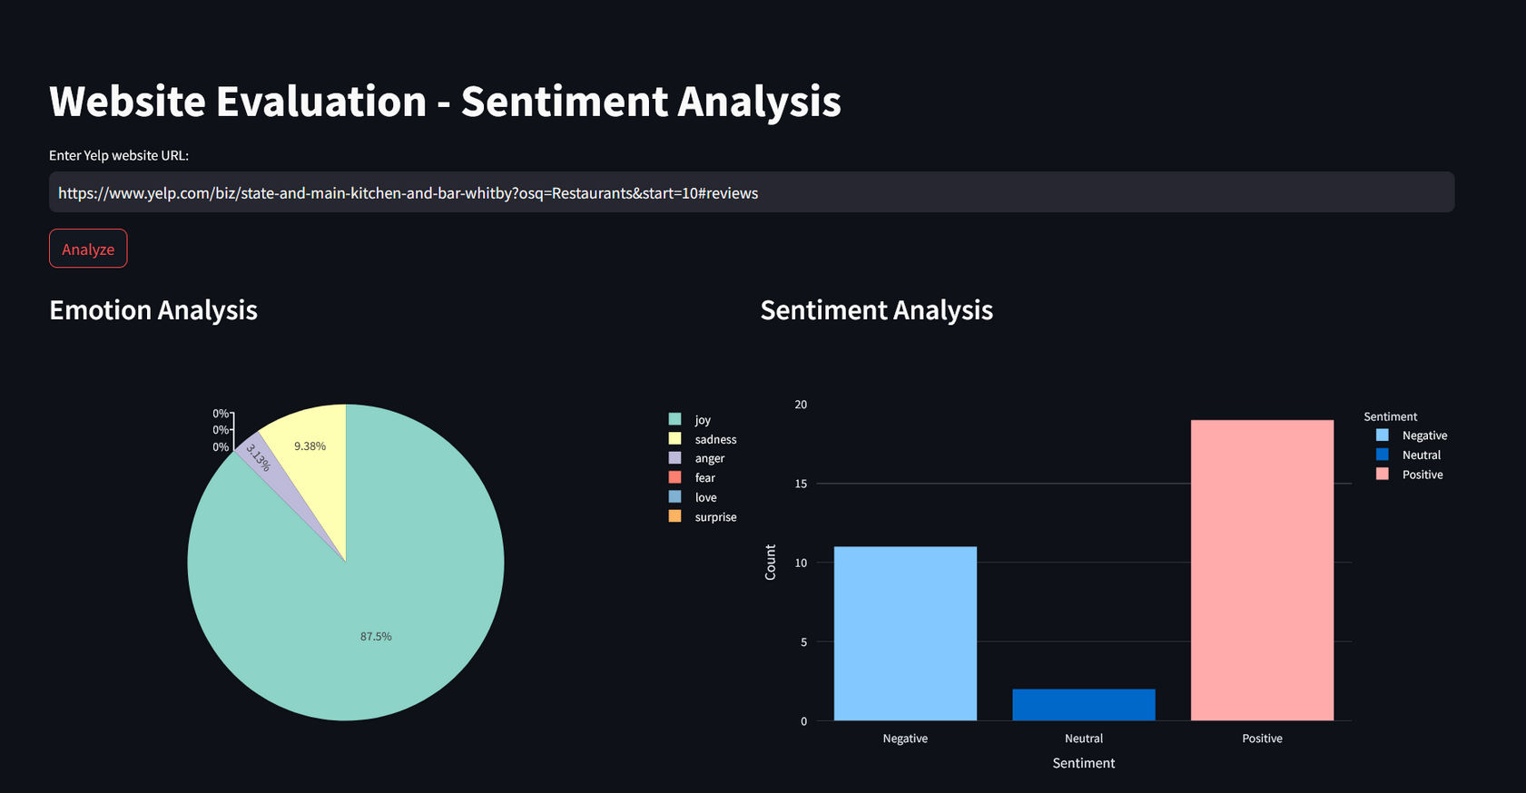

Basic Features
2.Sentiment Analysis:
Conduct sentiment analysis on individual reviews, determining whether the sentiment is positive, negative, or neutral, and assigning sentiment scores to each review.

Slide 6


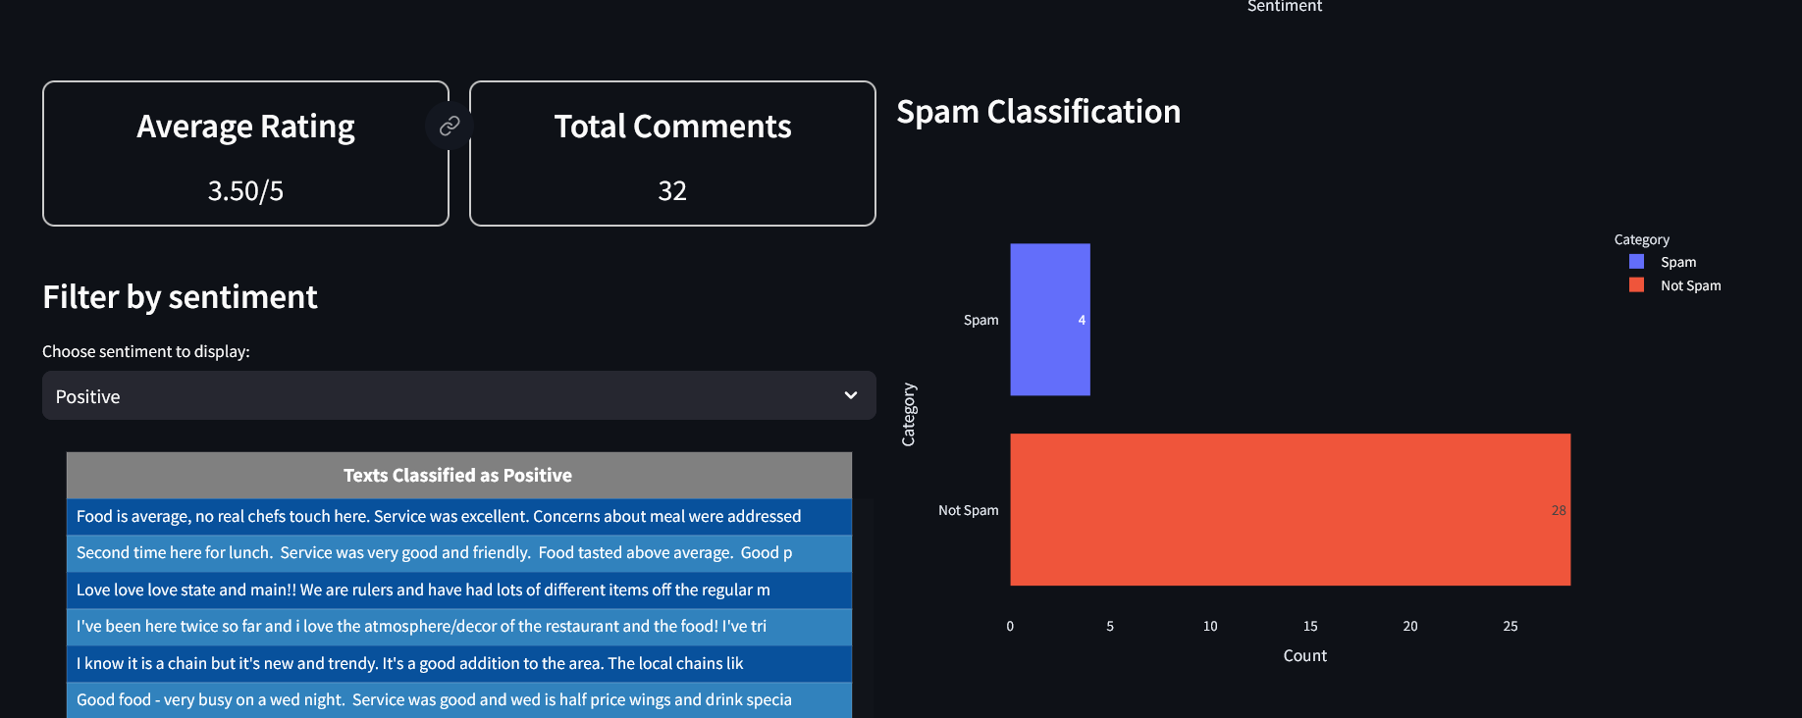

Basic Features
3.Overall website rating:
Aggregate sentiment scores to derive an overall website score, reflecting the collective sentiment expressed in the reviews.

Slide 7
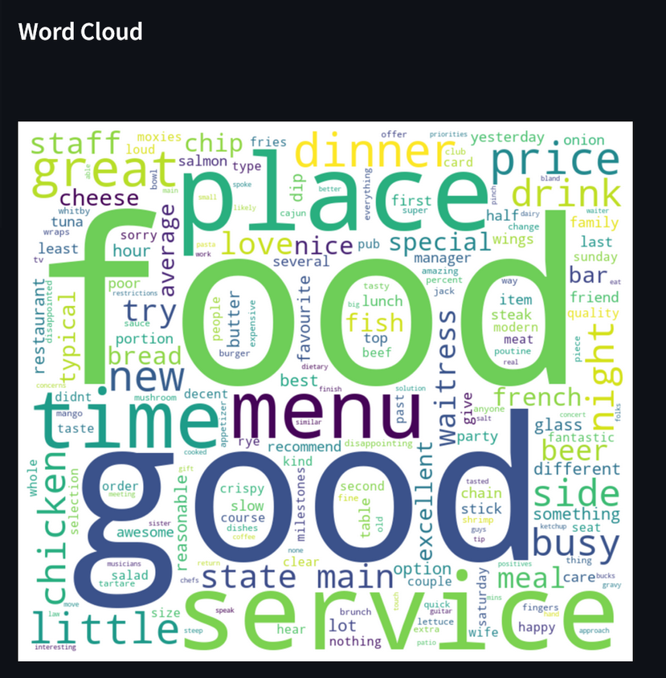

Basic Features
4.Feature/Keyword Extraction
Strategies are implemented for the extraction of pertinent features from review data, and a word cloud generation algorithm is utilized to visually depict the most frequently occurring keywords and phrases.

Slide 8



Advanced Features
5.Emotion Recognition:
Conducted Emotion Recognition to detect emotions expressed in text, such as joy, anger, and sadness. The users can enhance their customers experience by leveraging emotional feedback insights.

Slide 9



Advanced Features
6.Spam/Irrelevant comment detection
Determines whether the comment is
a spam/Irrelevant or an authentic comment.

Slide 10



Advanced Features
7.Interactive Dashboard a.k.a User Interface
Showcases the results of the analysis through an interactive dashboard, presenting information using charts, graphs, and word clouds in a user friendly manner.

Slide 11
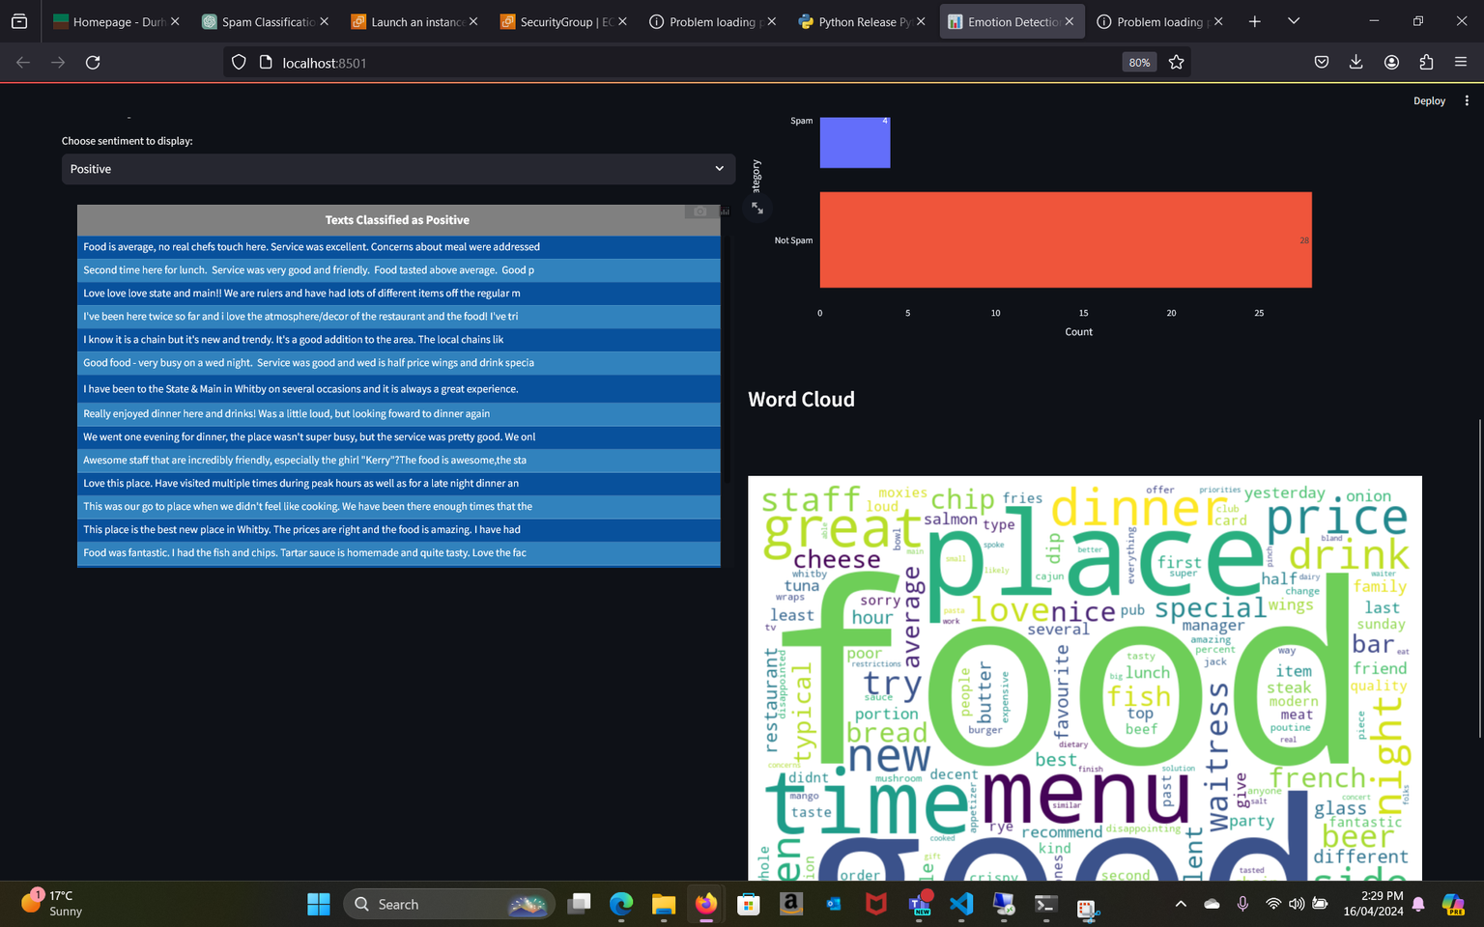
Advanced Features
7.Interactive Dashboard a.k.a User Interface

Slide 12



Thank
you!

